Slide 1
Village of Nyack
Budget Analysis 2024-25
FIRST DRAFT
Mayor Joe Rand
Version 3.29.2024

Slide 2
What’s in this Presentation
A Schedule for the Nyack Budget Process for April 2024.
An Overview of the Nyack Budget Revenue Projections.
An Overview of the Nyack Budget Expense Projections.
A Description of 10 “New Proposals” for the 2024-25 Budget.
Pie-Chart Graphs for the Overall Revenue and Expense Budgets
Line-Chart Graphs showing long-term trends for both revenue and expenses since 2018.

Slide 3
Budget Process Schedule
The current budget is a “First Draft,” which has expenses about $138,000 higher than projected revenues – a gap that we need to eliminate by the time we pass the budget.
Over the next month, the Village Board will hold a series of meetings and workshops to discuss the budget (all these are open to public comment):
  Thursday, April 4, 5PM: Budget Workshop
  Thursday, April 11, 8:00PM: Official Public Hearing
  Thursday, April 18, 6PM: Budget Workshop
  Thursday, April 25, 7:30PM: Village Board Meeting to Pass the final budget.
  All meetings will be broadcast on the Village Youtube page: https://www.youtube.com/@VillageofNyackAdmin
You can find all the budget resources in a file at www.nyack.link/budget

Slide 4
Overview of 2024-25 Budget: Revenues
Overall Revenues are Currently Projected to be $6,419,296.
This is a $337,018 increase from the 2023-24 budget, a 5.5% increase.
This includes the following increased projections:
  A 2.4% increase in the property tax, within the “tax cap” recommended by New York State.
  A 67% projected increase in the hotel tax, based on this year’s actuals.
  A 37% increase in building permits, based on development proposals in the pipeline.
Overall, the current revenue projections about currently $137,882 lower than the budgeted expenses.

Slide 5
Overview of 2024-25 Budget: Expenses
Overall Expenses are Currently Projected to be $6,557,178.
This is a $474,804 increase from the 2023-24 budget, a 7.8% increase.
This includes about $380,000 of new proposals for this year (see next slide), all of which still need to be reviewed.
The Board might also cut other expenses in order to balance the budget based on the projected revenues.

Slide 6
Major New Proposals for 2024-25 Budget
What follows are 10 new discretionary proposals that involve expenditure increases of more than $10,000 for the 2024-25 budget.
These proposals are based on requests from Village departments, administrators, or the Village Board.
The total amount of these proposals is about $380,000.
Note that the current budget gap in this first draft is about $138,000, and we need to balance the budget, so we will need to either
  Cut or scale back some of these proposals;
  Cut other budget expenses that are not currently set for any major new proposals; or
  Raise revenue projections in some way.
Note that most of the expenses in our budget are non-discretionary: union salaries, health benefits, facility fees, debt service, etc. So the only way to balance the budget is through managing the discretionary expenses -- like these new proposals.

Slide 7
10 New Proposals (By Size Order)
$75,000 to increase the budget for Camp Nyack to extend the camp summer season (from $124,500 to $199,500).
$55,000 for road paving on top of what is provided through state funds and grants.
$50,000 for a new electric vehicle for the Safety Inspection staff.
$48,880 for new computer equipment and software for administrative staff.
$47,257 for salary increases for judicial employees, to become competitive with other municipalities (raising from $147,741 to $194,999).
$40,000 for a “Reserve Fund” to start building rainy-day funds for the Village.
$25,000 for new sidewalk construction not covered by grants and state funds.
$25,000 (approximately) for raises for full-time non-union Village employees (most of which align with a 3% contracted raise for union employees).
$22,750 for a new “Quality-of-Life” Code Enforcer to help patrol the downtown streets for violations.
$12,500 for a stipend for our Sustainability Coordinator, a previously volunteer position that has become too big for unpaid work.

Slide 8
Overall View of Revenues and Expenses Proposed for 2024-25 Budget
Note: This is the first draft of the budget. The Board has not yet worked on balancing revenues and expenses, which will require either raising some revenue projections or reducing budgeted expenses.

Slide 9
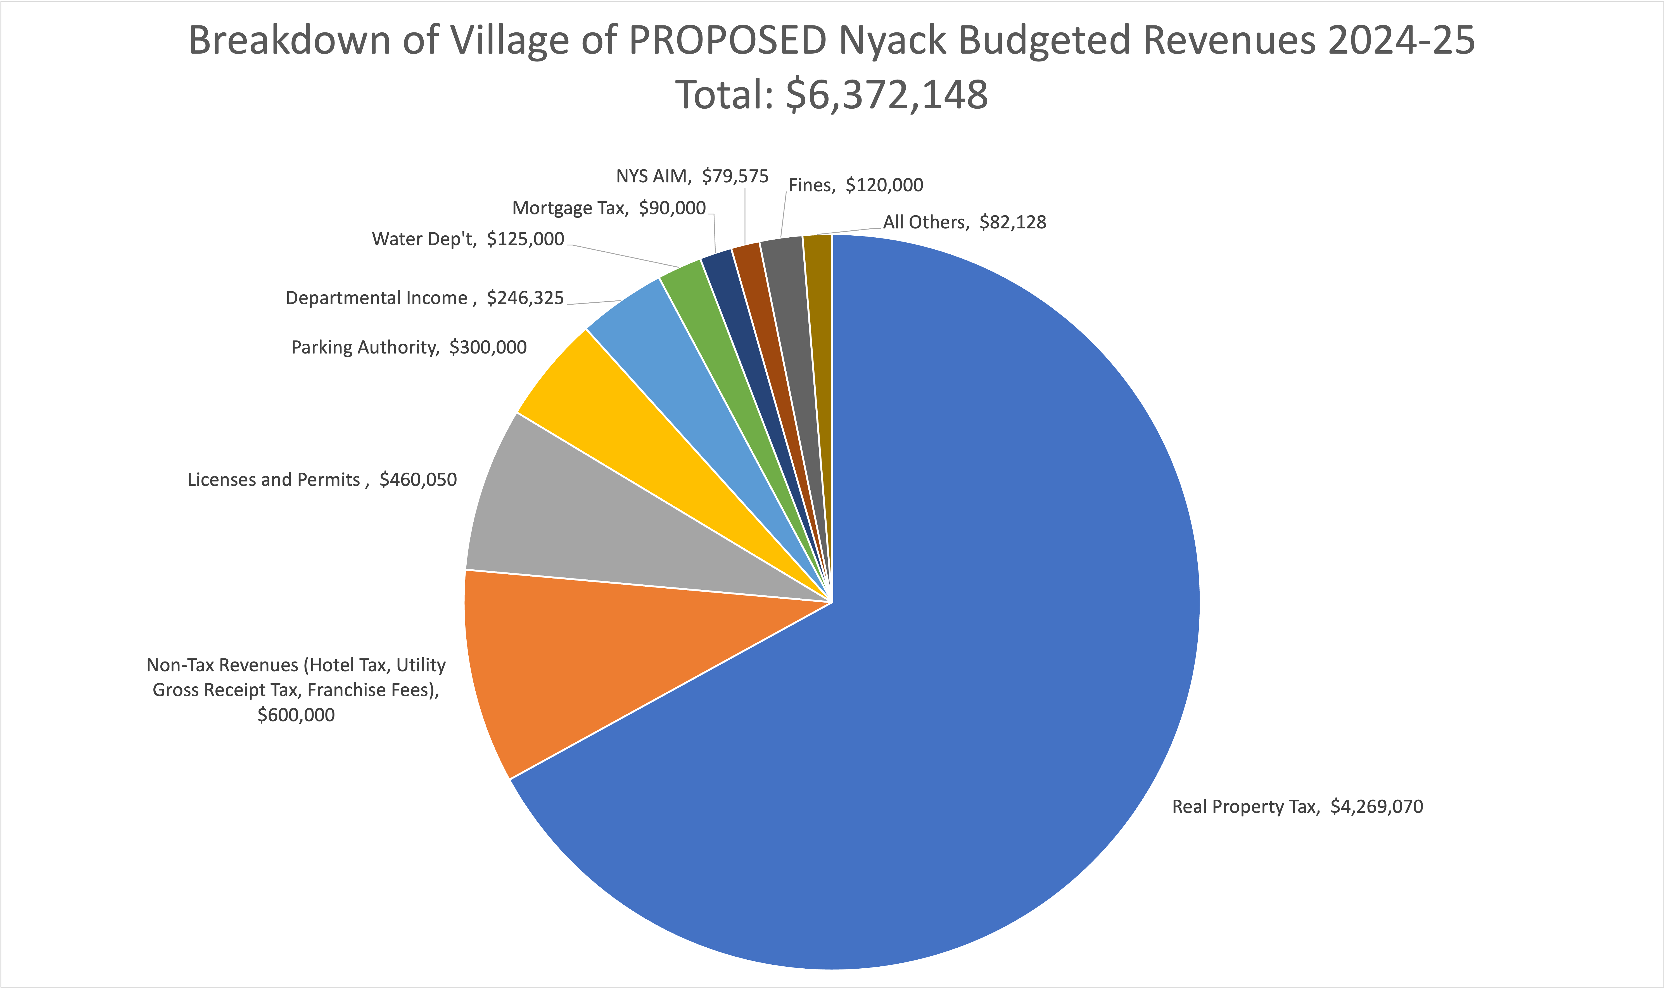

Slide 10
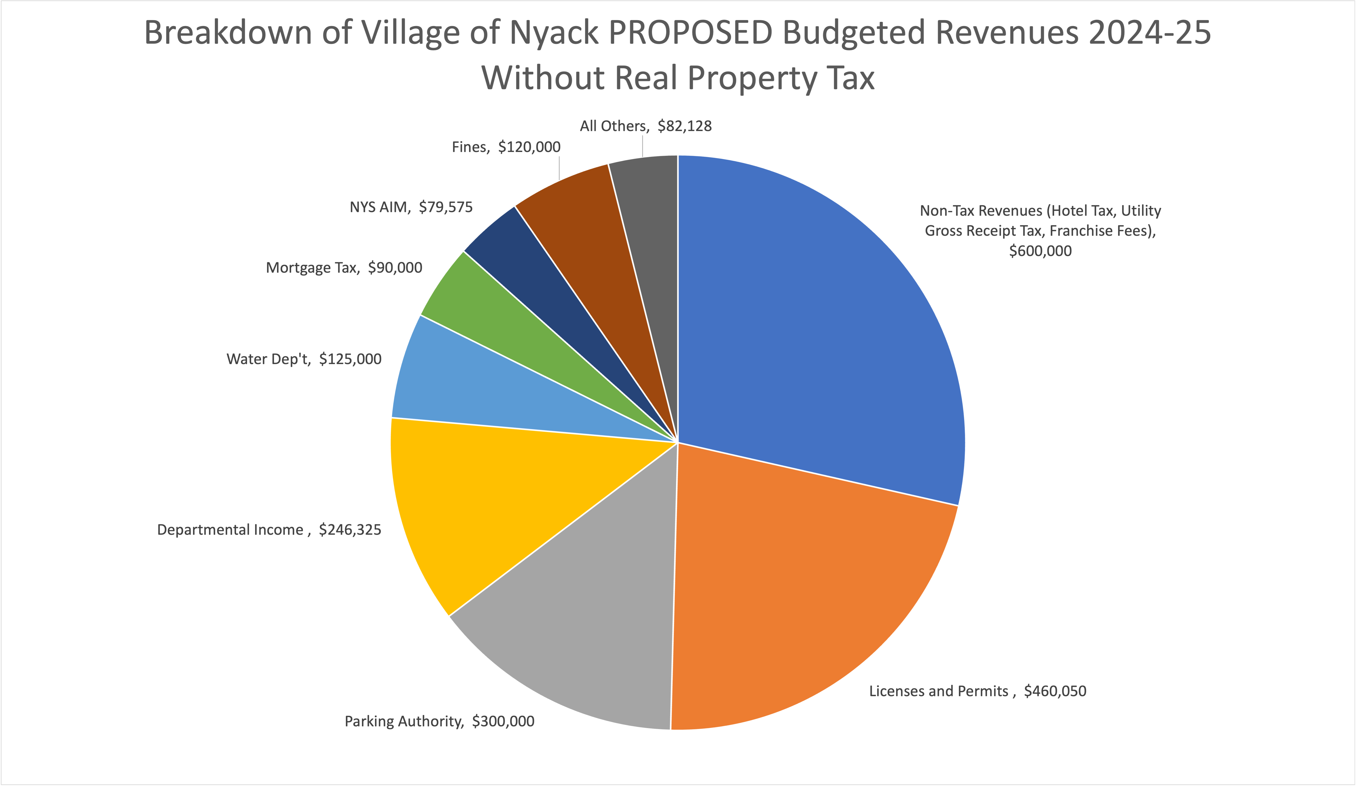

Slide 11
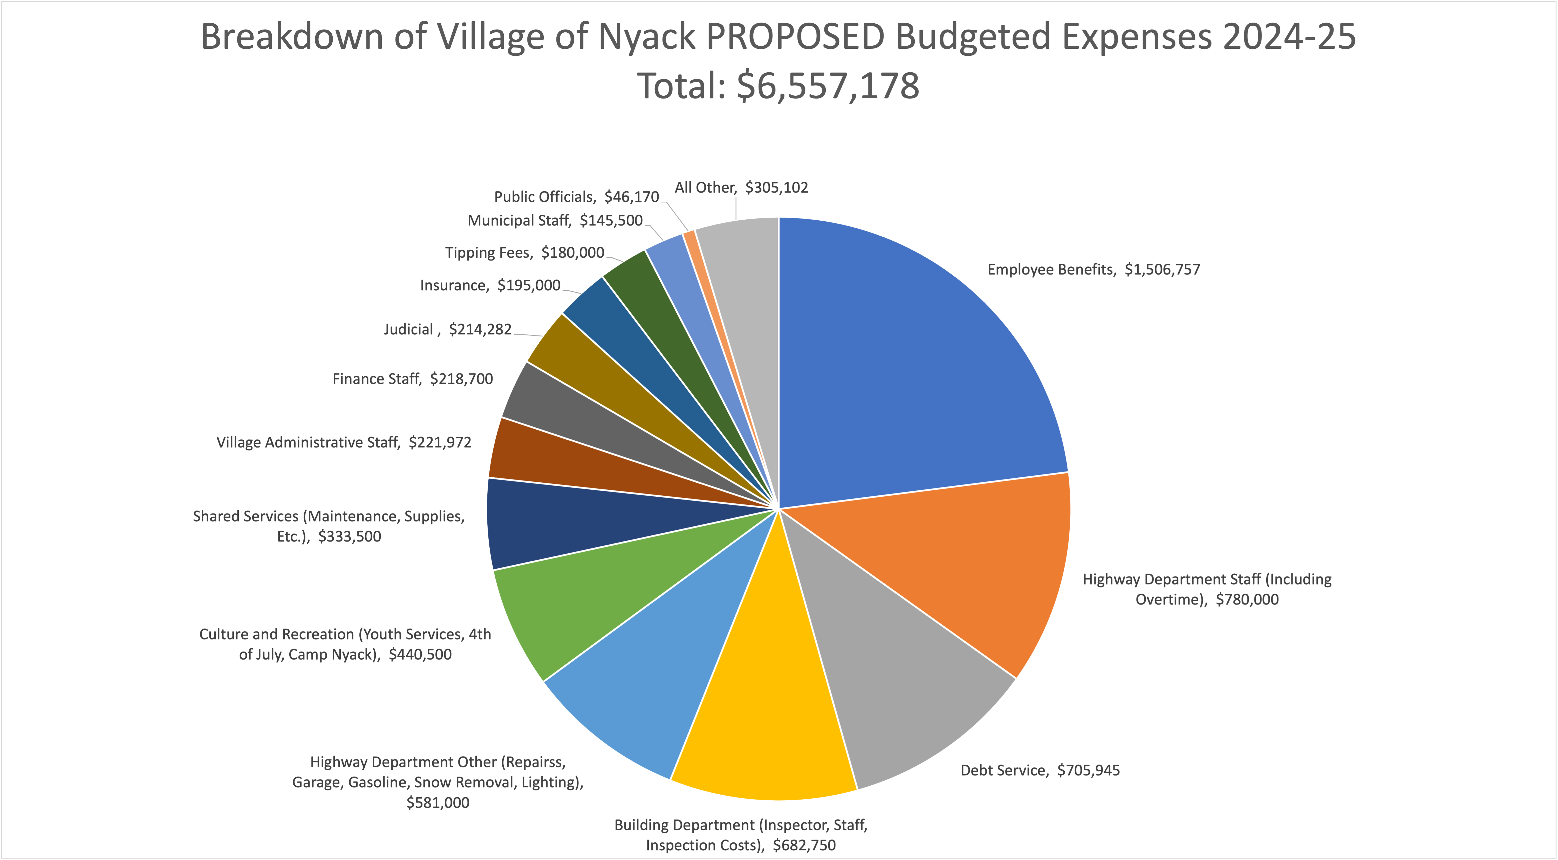

Slide 12
Year-by-Year Analysis of Nyack Expenses
Actual Expenses for Budget Years
2018-19
2019-20
2020-21
2021-22
2022-23
Budgeted Expenses for Budget Year 2023-24
(Since we don’t have full-year Actuals yet)
Proposed Expenses for Budget Year 2024-25

Slide 13
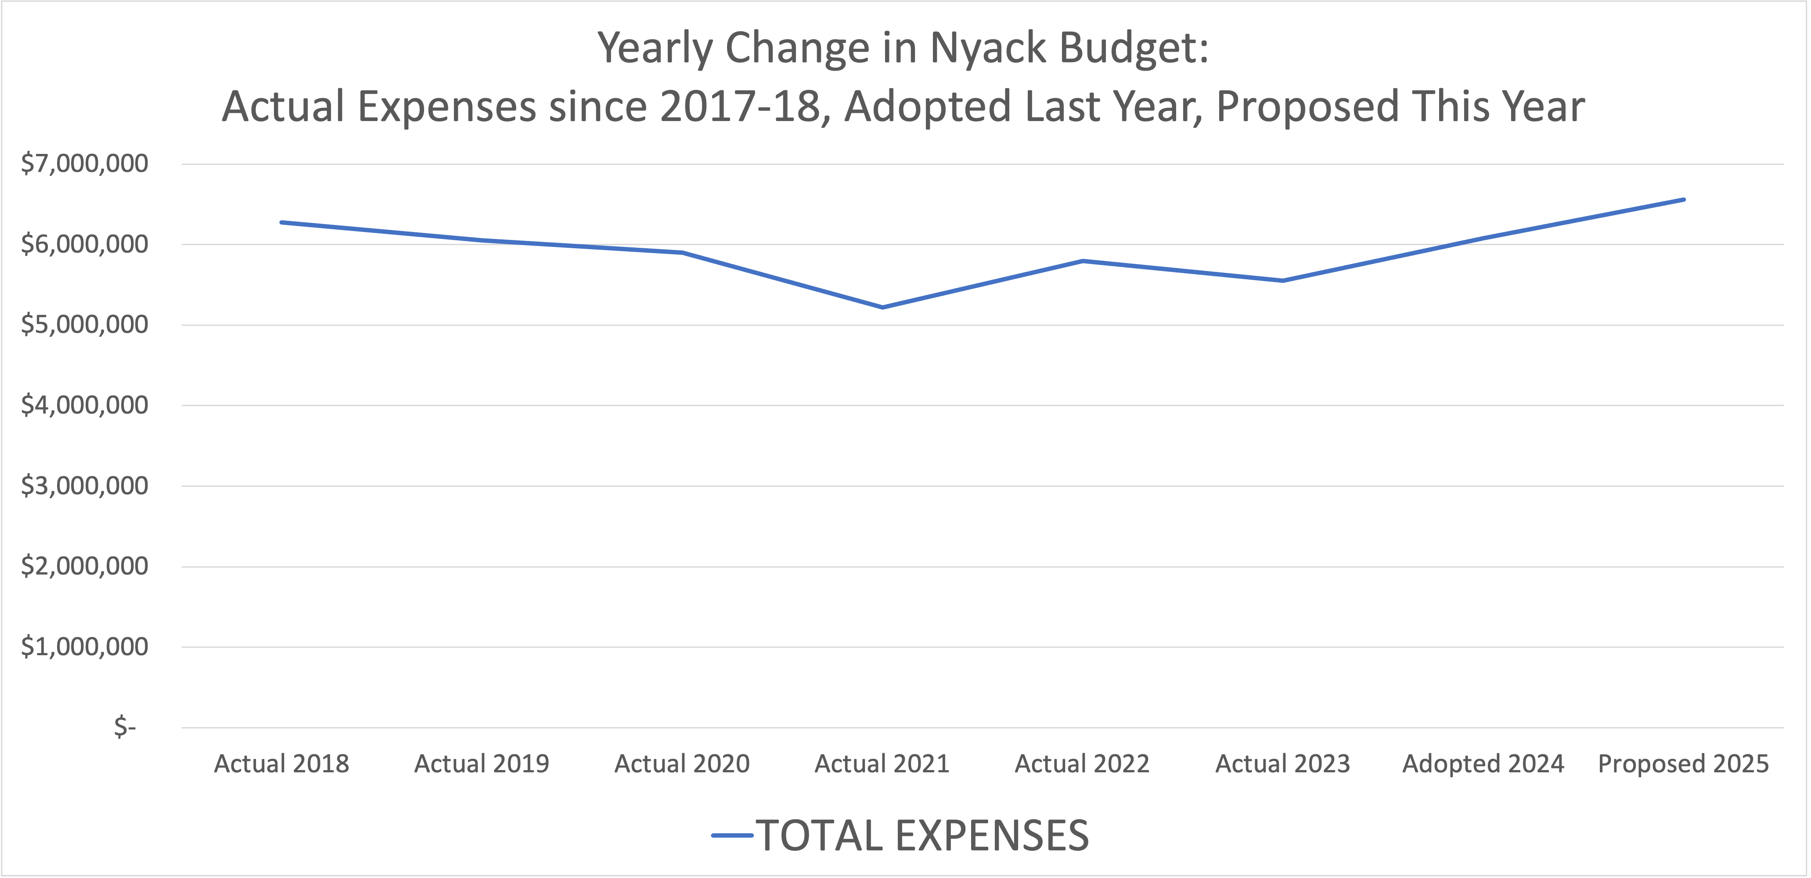

Slide 14
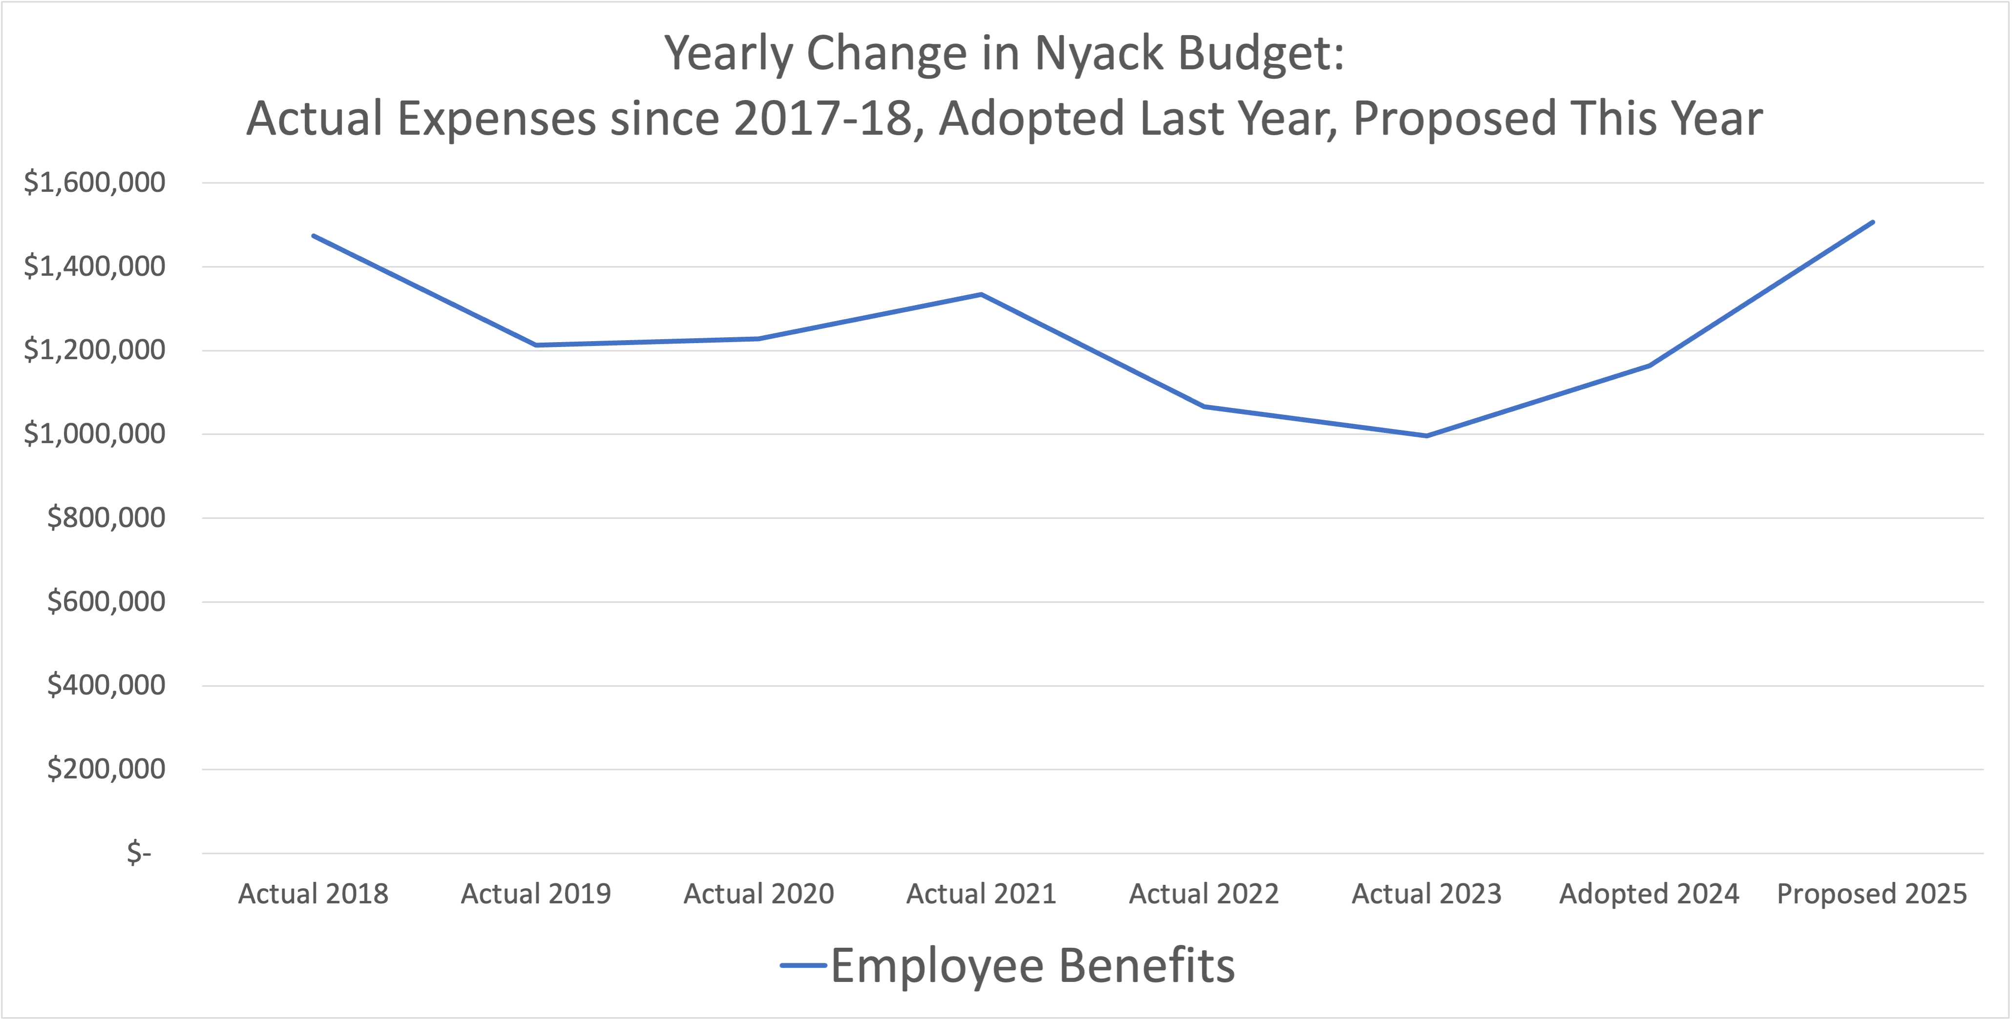

Slide 15
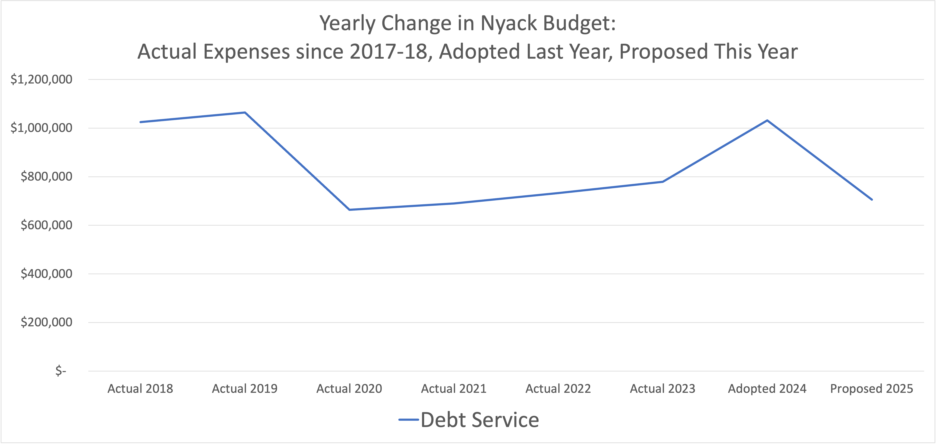

Slide 16
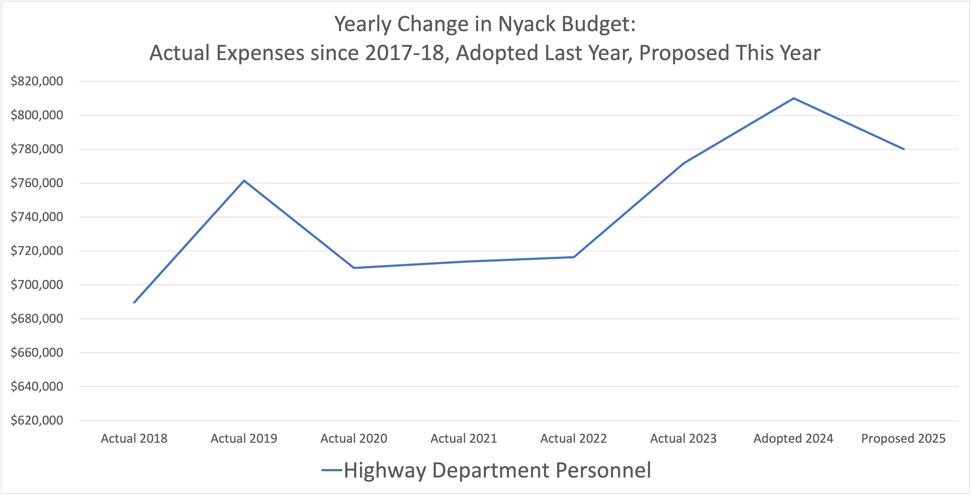

Slide 17
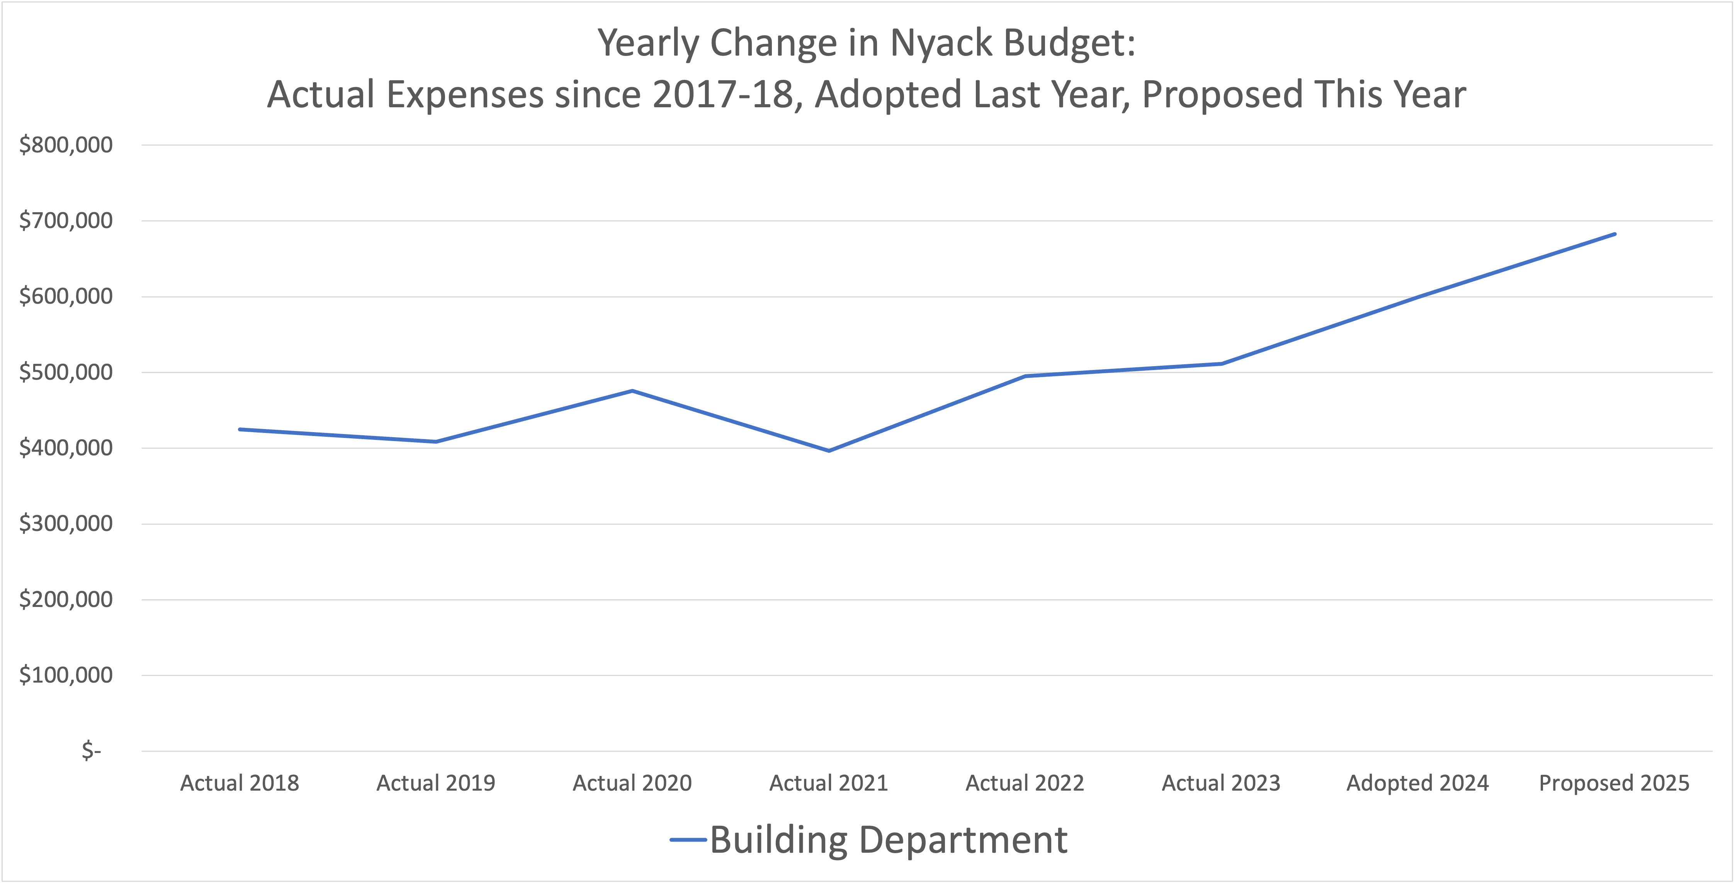

Slide 18
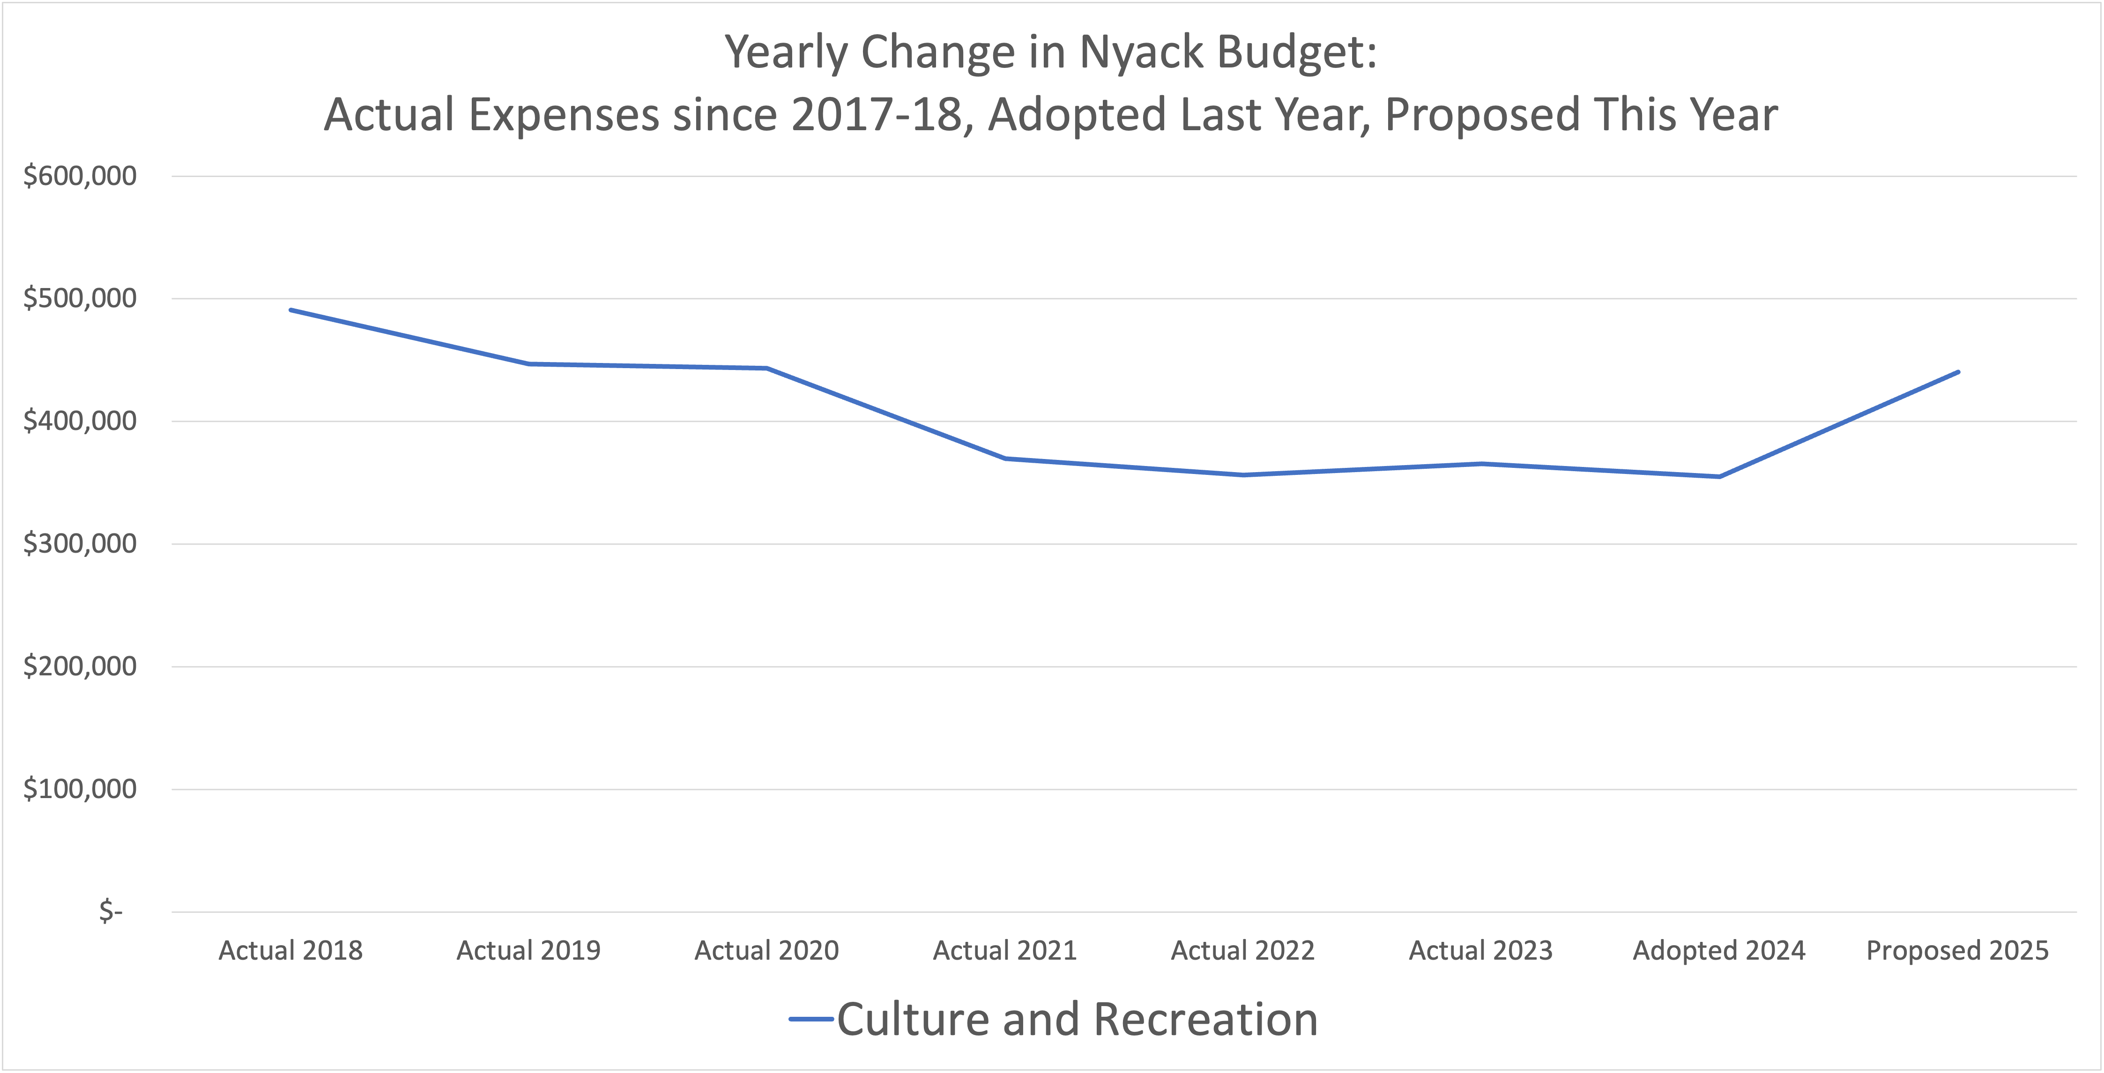

Slide 19
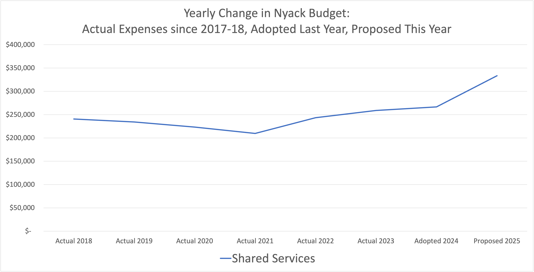

Slide 20
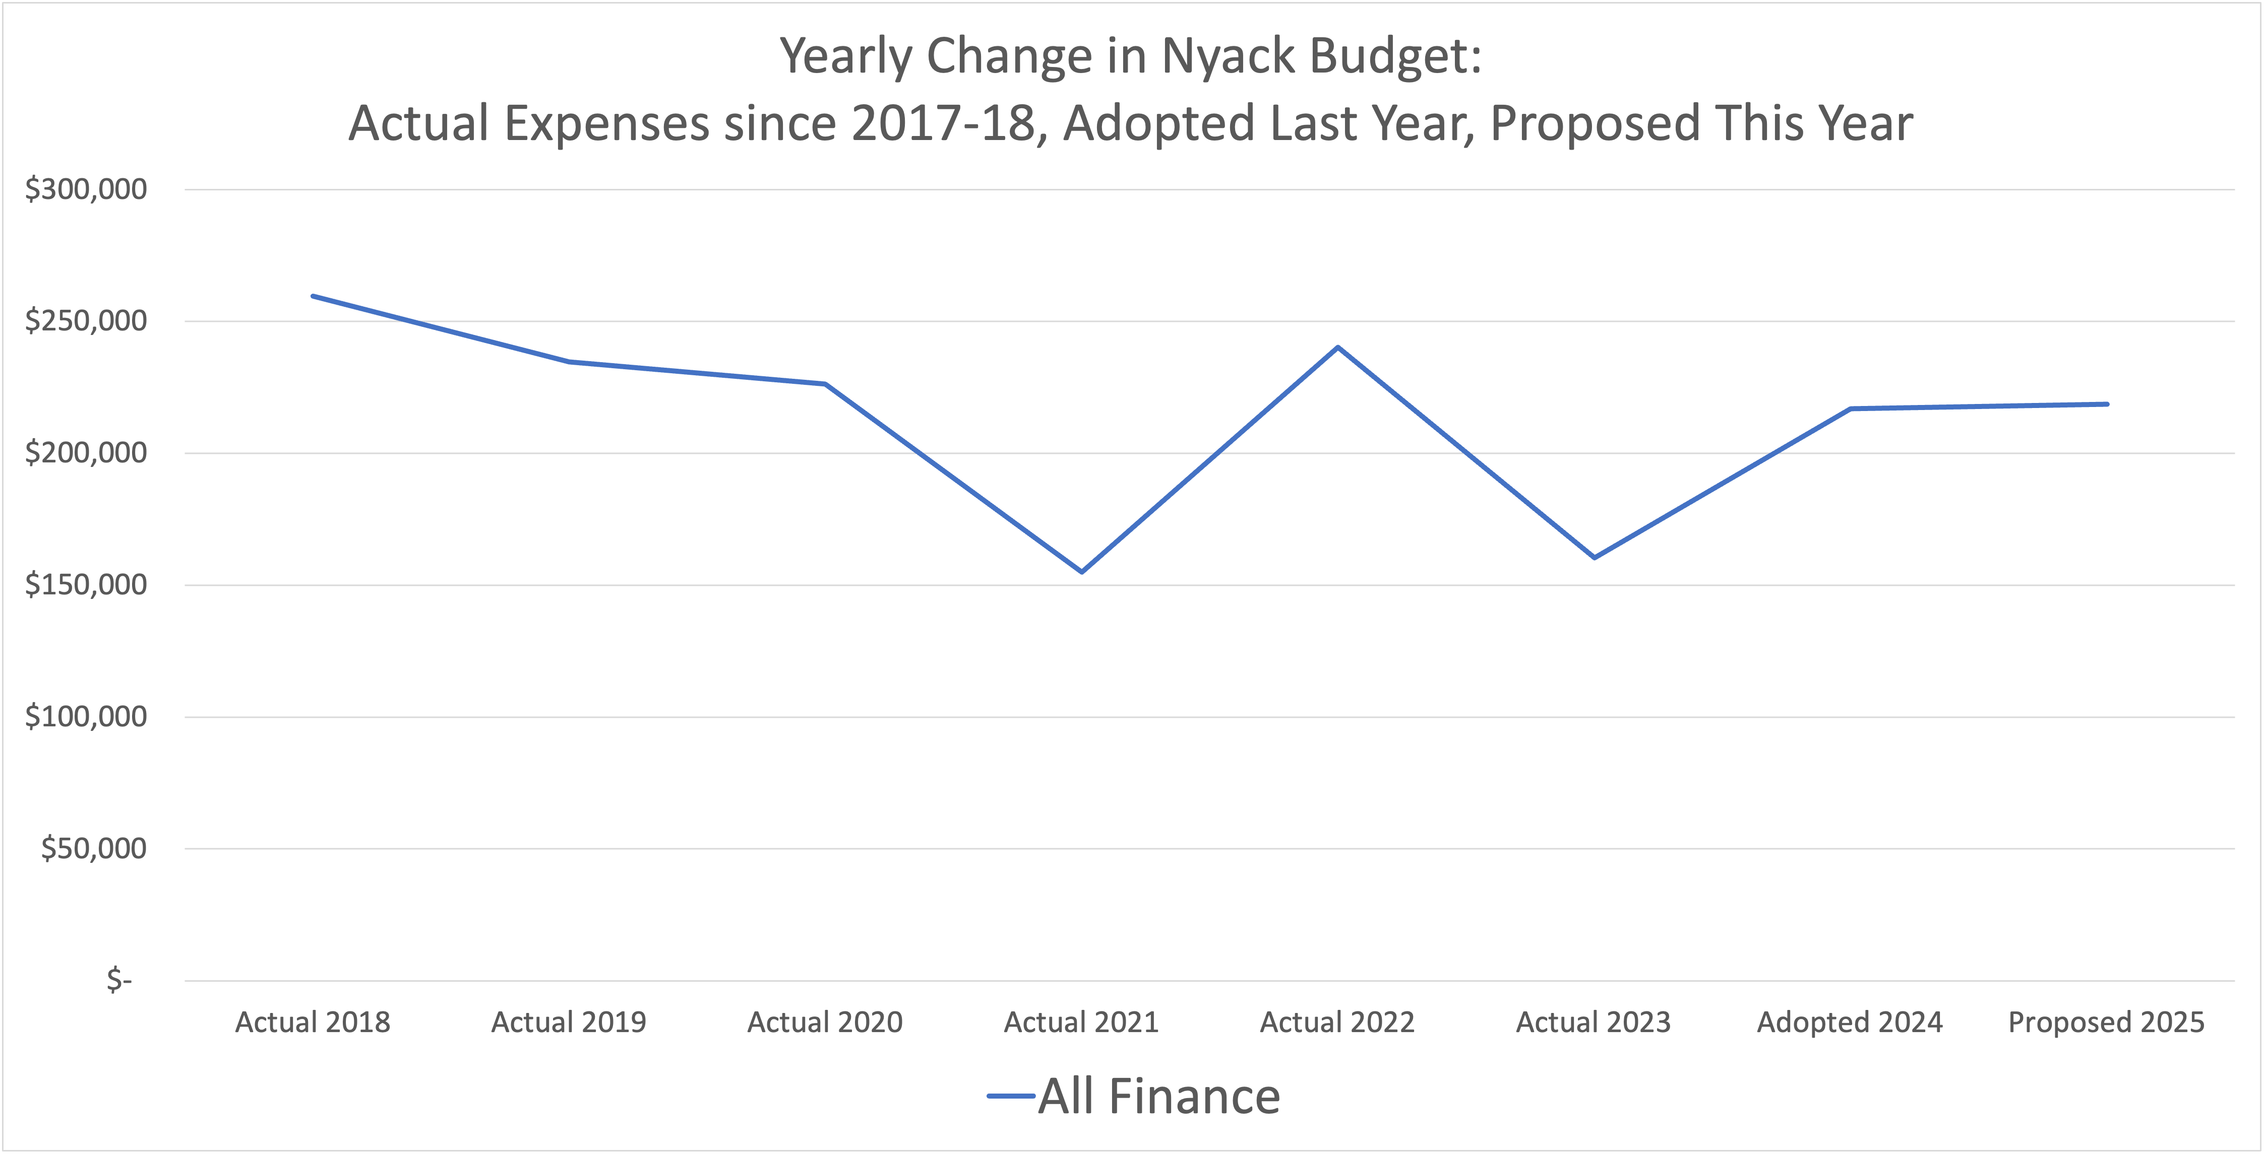

Slide 24
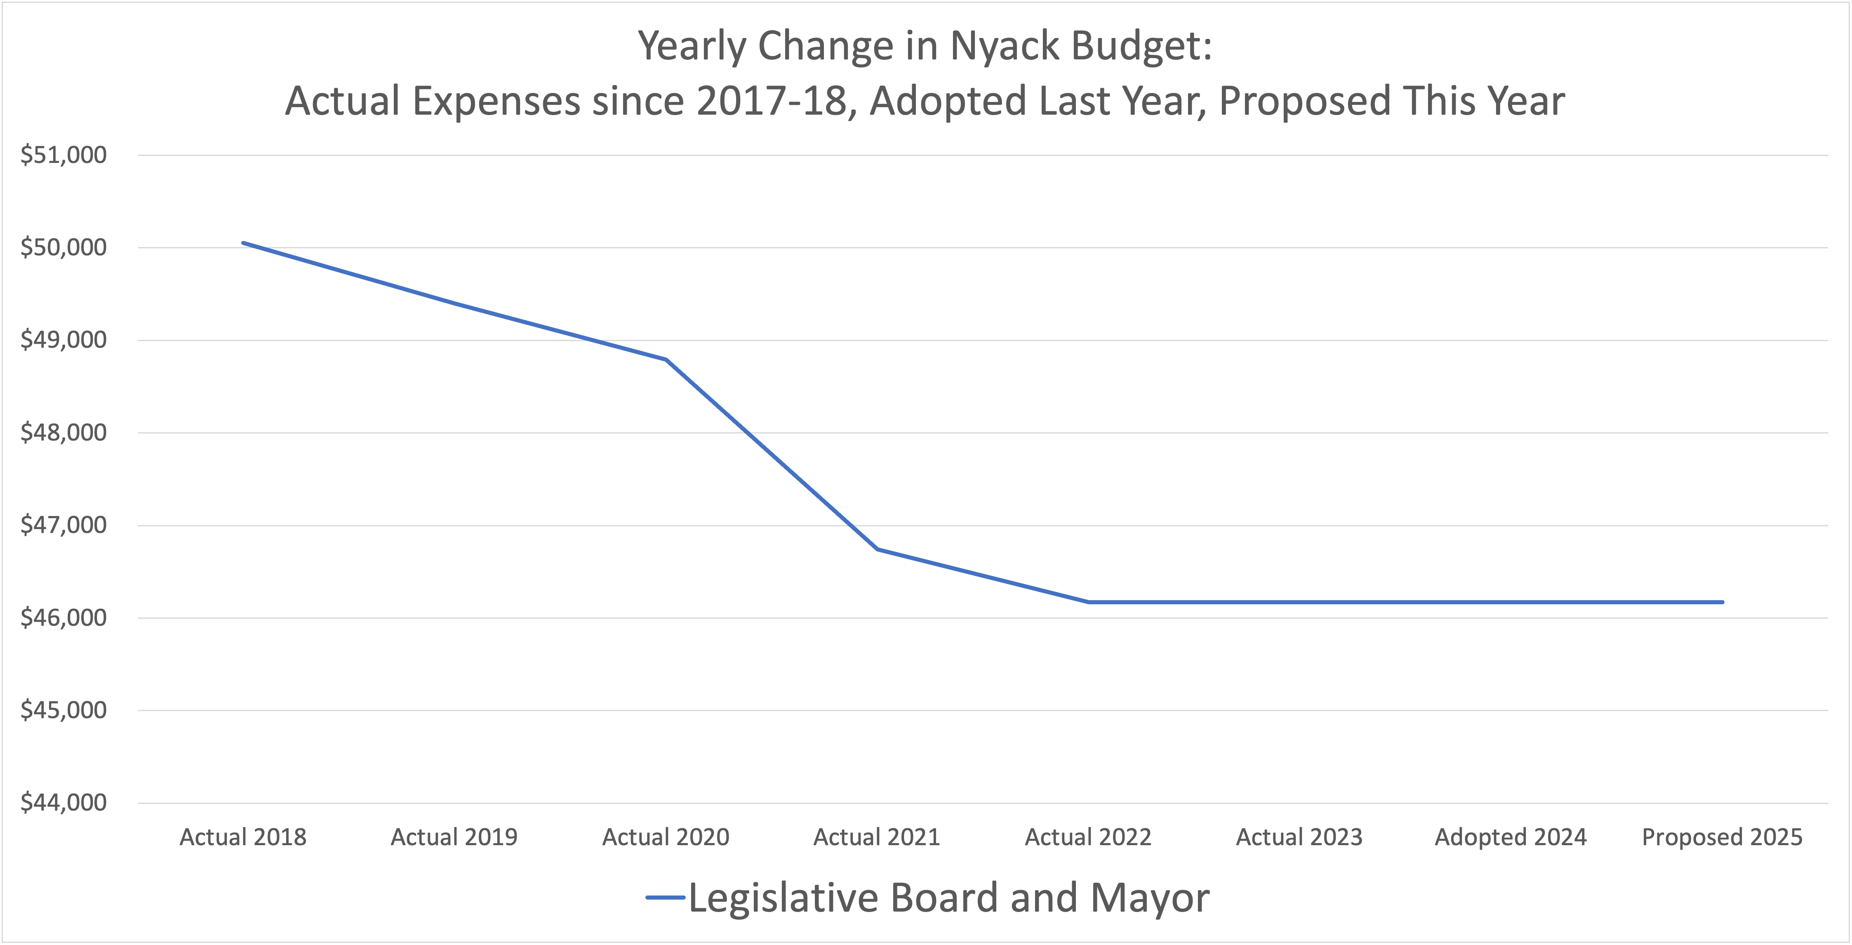

Slide 26
Year-by-Year Analysis of Nyack REVENUES
Actual Revenues for Budget Years
2018-19
2019-20
2020-21
2021-22
2022-23
Budgeted Revenues for Budget Year 2023-24
(Since we don’t have full-year Actuals yet)
Proposed Revenues for Budget Year 2024-25

Slide 28
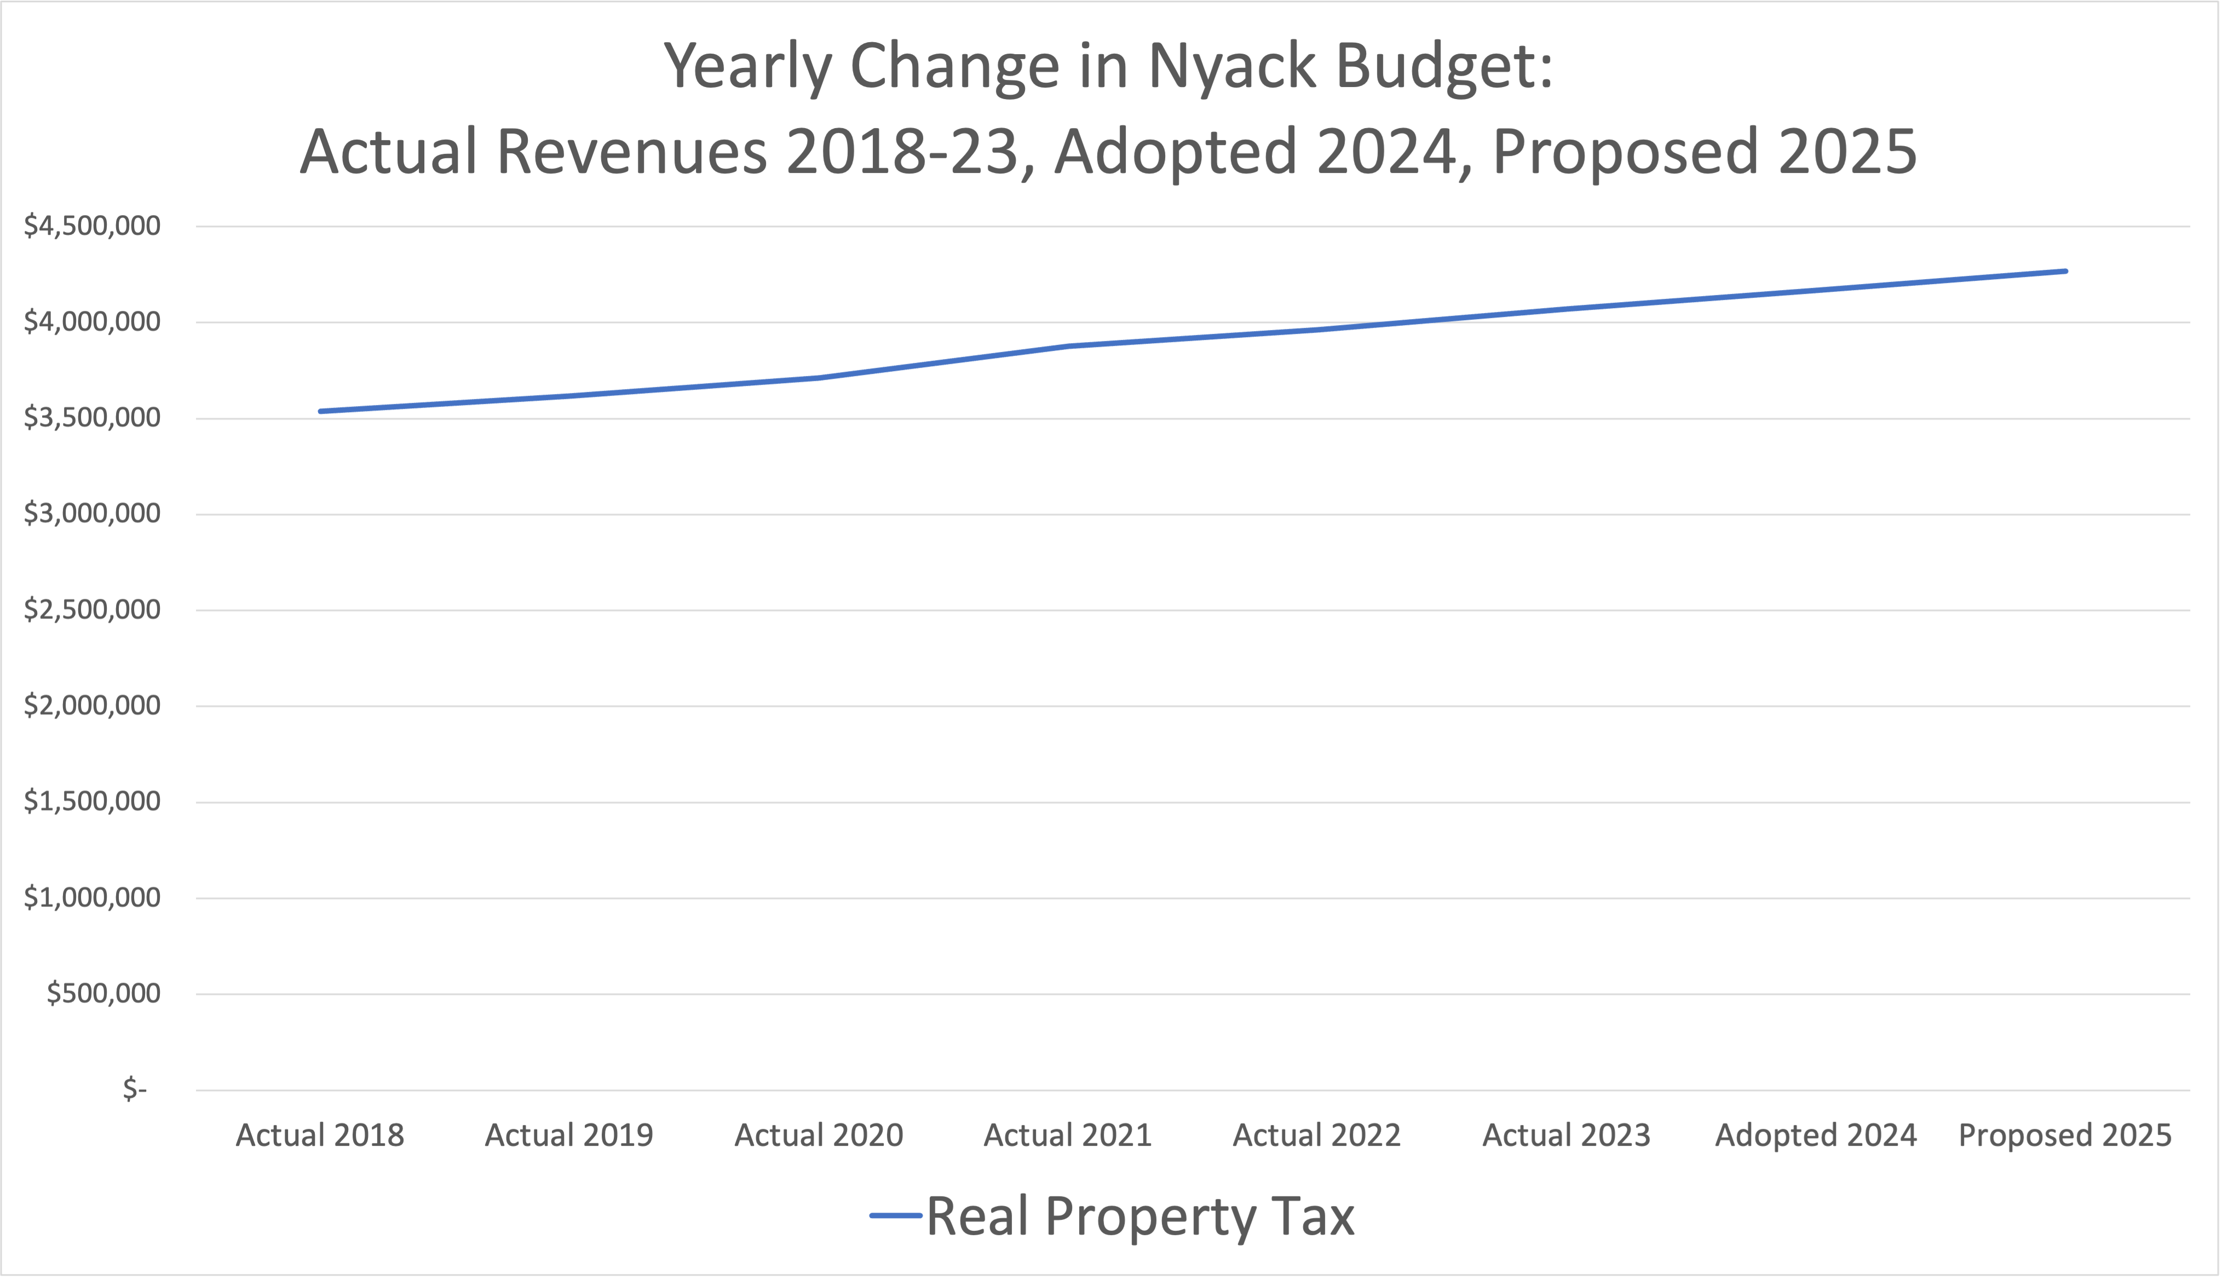

Slide 36
Resources
Budget docs: www.nyack.link/budget
Budget Workshops and Meetings
  Thursday, April 4, 5PM: Budget Workshop
  Thursday, April 11, 8:00PM: Official Public Hearing
  Thursday, April 18, 6PM: Budget Workshop
  Thursday, April 25, 7:30PM: Village Board Meeting to Pass the final budget.
Questions? joerand@nyack-ny.gov.

